Slide 1





JoJo Technology -
Iteration 3
Group Member: Amy Nguyen, Zhuoyue Sun, Jiahao Zhang, Xiaocheng Kang

Slide 2



1.
Burn down Chart
And Task Board
Presenter: Zhuoyue Sun

Slide 3
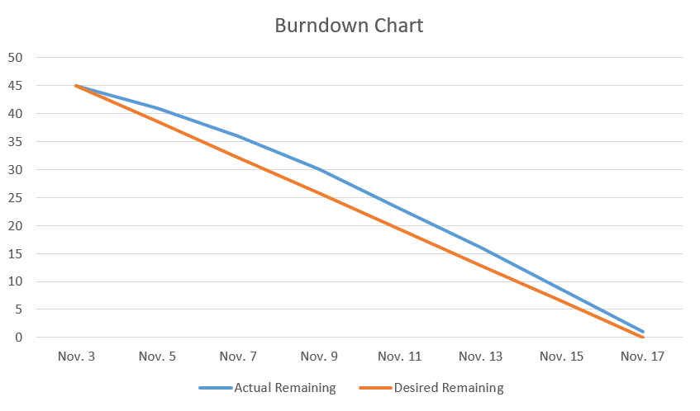
Burndown Chart
Days worked: 14 days
Estimated time: 45 hours
Work 3.1 hours per day
Velocity for iteration 3: 0.7
Final velocity: 0.75
Residual task

Slide 4
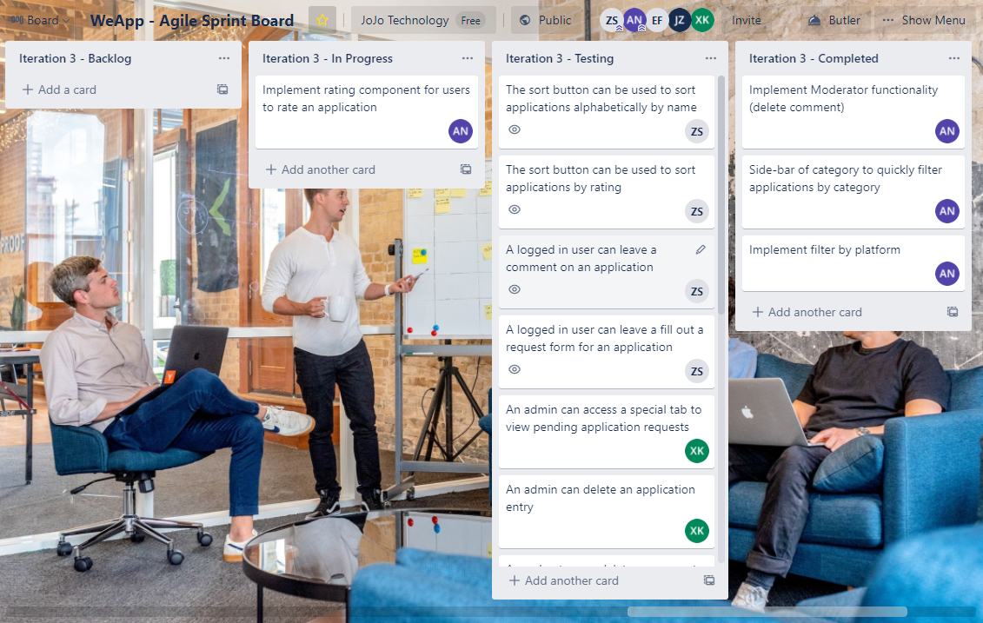
Trello Task Board
Functionality:
Moderator function
Filter by platform
Side-bar
Rating (low priority)
Testing:
Sort function
Comment
Admin function
App request

Slide 5








2.
Screenshots
Presenter: Xiaocheng Kang & Jiahao

Slide 6
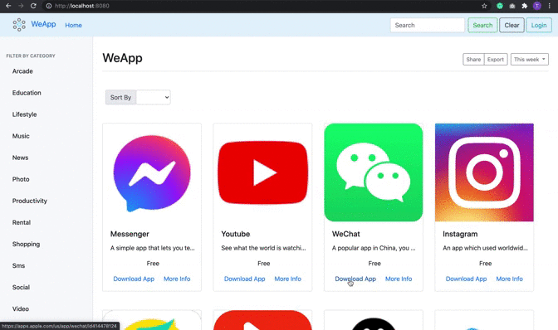
This is our current homepage - Everyone (including unregistered user) can access this page

Slide 7
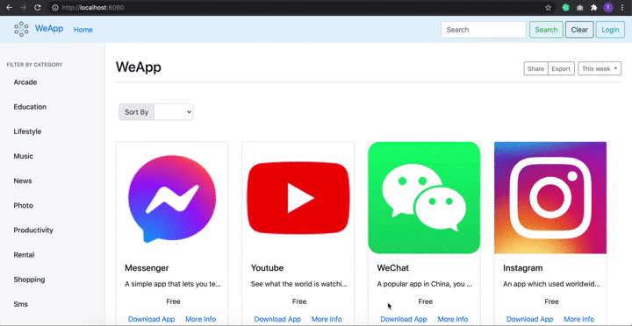
Filter by category functionality (for example, education, news, music, video, etc)

Slide 8

Sort by name functionality in ascending order (from A-Z)

Slide 9
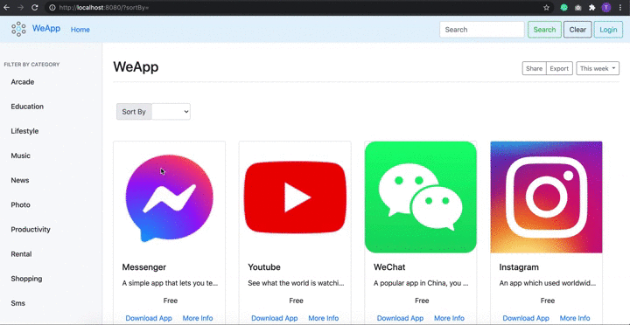
Sort by price functionality (in descending order)

Slide 10
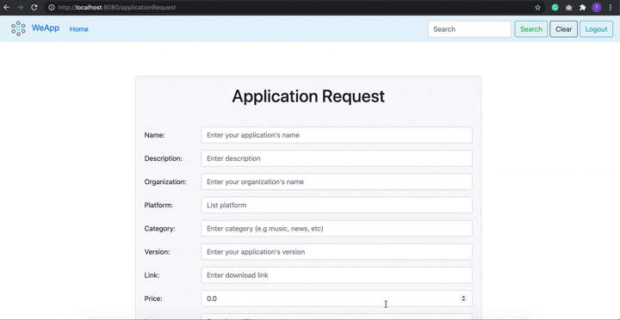
Add an application request form (with client-side validation). Warning messages upon submit if fields are incorrectly filled.

Slide 11
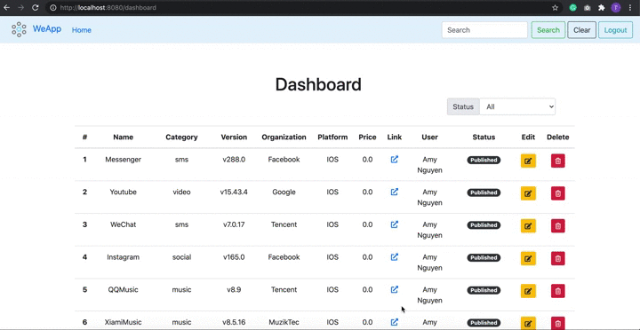
Dashboard view of application. Only admin can access this page and perform actions like editing or deleting an app. If an admin, click on delete button, a warning message will pop up to confirm deletion.

Slide 12
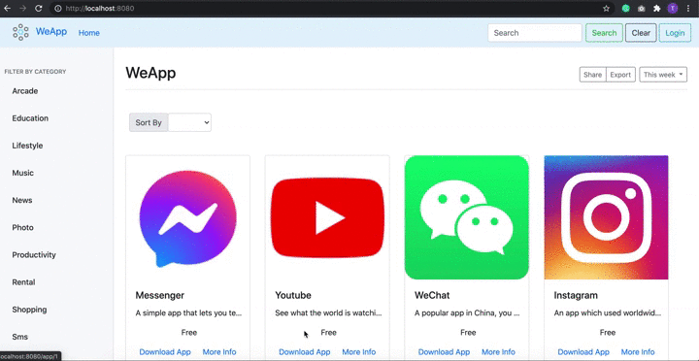
When clicked on the ‘More Info’ link on each app, it directs the users to a page that shows more information about the particular app (name, company, description), and a slideshow of screenshots. Below, there is a comment section

Slide 13
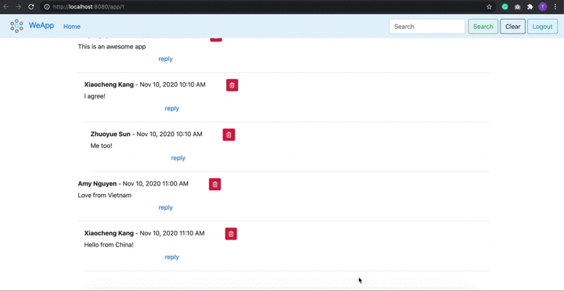
Recursive comment functionality. The comments are nested properly to indicate which comments reply to a comment. There is also a timestamp for each comment.

Slide 14
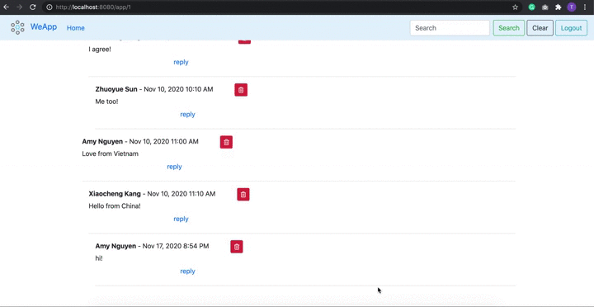
Only moderator can see a delete button next to each comment. If a moderator, click on delete button, a warning message will pop up to confirm deletion. When a root comment is deleted, all of its child comments get deleted too.

Slide 15
3.
Testing
Presenter: Amy Nguyen

Slide 16
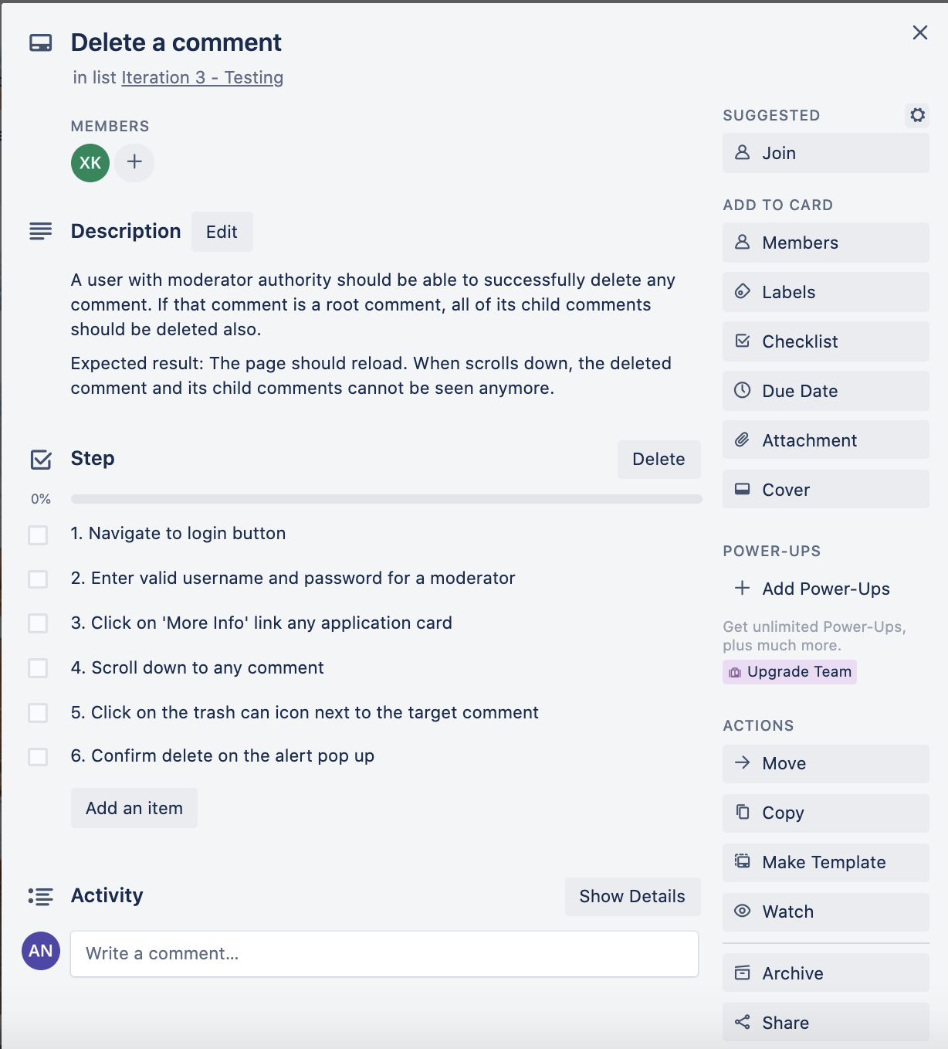
System Testing Strategy
What & How:
Write test cases with
concise and descriptive title
brief description
clear steps to conduct test (inputs)
expected result
Carry out tests (build project & go to localhost:8080 to start)
Who: QA Testers/Users

Slide 17
List of System Testing Cases
Search bar works and is not case sensitive
Applications are displayed correctly on the home page with their icons, names, profiles and prices.
The “Download App” button can be used to take us to the app store to view and download the application.
The “View Info” button can be used to take us to a page that contains more information about the app (name, company, short description, and screenshots)
The sort button can be used to sort applications alphabetically by name
The sort button can be used to sort applications by price
A logged in user can leave a comment on an application
A logged in user can leave a fill out a request form for an application
An admin can access a special tab to view pending application requests
An admin can delete an application entry
A moderator can delete a comment

Slide 18
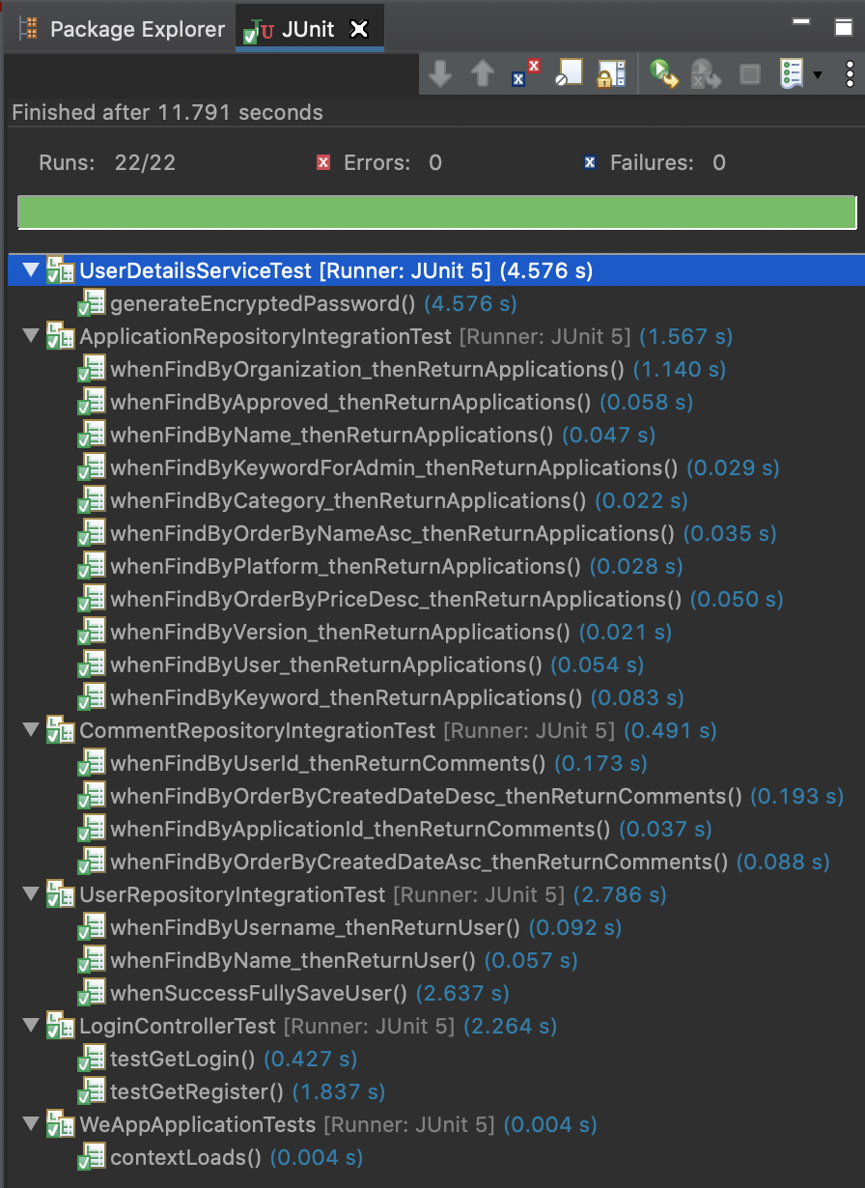
Unit & Integration Testing Strategy
What & How:
Decide on the type of integration testing approach
writing tests using the framework support in Spring Boot.
Integration Testing for Repositories With @DataJpaTest (provides some standard setup needed for testing the persistence layer)
Mock the Service layer code to test controllers
@SpringBootTest to bootstrap the entire container.
track error and record test results
repeat until complete system is tested
Who: Developers write unit & integration testing

Slide 19
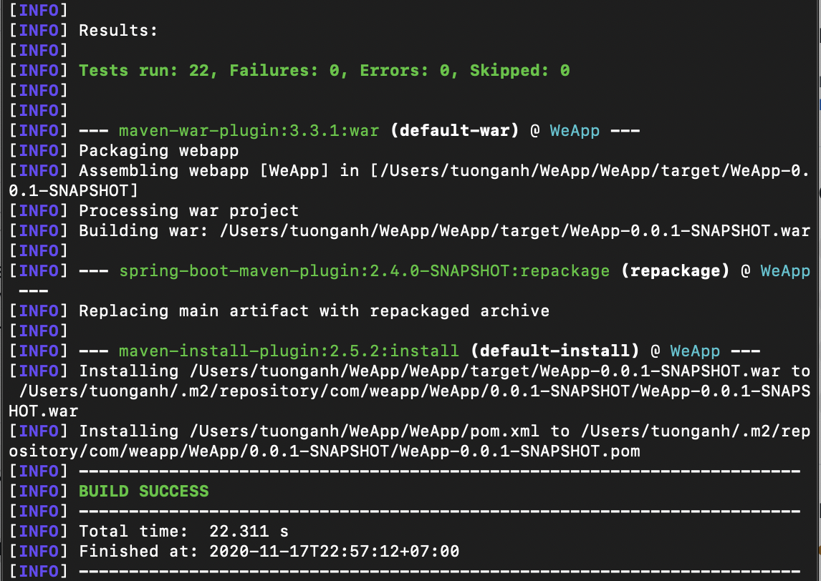
Unit & Integration Testing Result

Slide 20
Interesting Bugs
Bug #1: When moderator tries to delete a root comment, not all of its child comments get deleted
Solution: revisit entity model → entity state transition starts from parent to child elements (@OneToMany relationship)
Bug #2: Incorrect handling of HTTP GET & POST requests
there are many instances of this
one is search bar on admin dashboard redirects to homepage
another is letting unregistered user see features for registered users only

Slide 21
4.
Retrospective
Presenter: Everyone

Slide 22
What went well/what did you enjoy about the project?
Learn about and practice Agile Methodology (Amy)
Provide disciplined and structured project management that keeps everyone productive and motivated
Deliver high quality deliverable at the end of each iteration
Working with a customer, adapt software to their needs & get feedback
→ All translate to real-world applications
Professional knowledge by learning multiple frameworks: (Jiahao)
Java Back-end with Spring boot
Front-end framework with Bootstrap
Teamwork
Work in a team with multiple positions (project manager, technical manager, testers, developers)
Effective communication and task assignments

Slide 23
What would you do differently knowing what you know now?
Process (Kang)
Use communication tools like Slack for better team collaboration and increase productivity by keeping all communication in one app
Technology (Zhuoyue)
Implement Test Driven Development and Continuous Integration from the start
Improving architecuture and design
Consider using GitLab to get metrics for Agile and keep task board + code base in one place

Slide 24
Lessons learned?
Everyone presents their key takeaway (1-2 sentence)
Amy: Communication is key!
Jiahao: Learn new knowledge is the key.
Zhuoyue: Identify the cause of problem.
Kang: Cooperation is the key

